Slide 1
Design Principles and SOLID
Sampath Bingi

Slide 2
Agenda
#
Design Principles definition and purpose
#
Programming principles : solid
#
Programming principles : other

Slide 3
Design principles

Slide 4
Design Principles Definition
Design Principles – is an idea of components structure that boosts particular attributes.
In other words, if your code just works, your reached lowest level of quality.
Notes:
What are design principle?
The Principles are concepts used to organize or arrange the structural elements of design.
Design principles are sets of generally applicable laws, guidelines, human biases, and design considerations.
Principle used in architecting software.
Why Need Design principle?
Never have requirement upfront.
Requirements changes as we go along.
code should be supple(flexible), when requirement change code fit to change.
System should not break.
Supple -make more flexible.

Slide 5
Design Principles Purpose
Design principles purpose is to avoid bad design characteristics:
Rigidity - It is hard to change because every change affects too many other parts of the system.
Fragility - When you make a change, unexpected parts of the system break result is you have to do impact analysis in whole project.
Immobility - It is hard to reuse in another application because it cannot be extricate from the current application.
Notes:
The design principles are associated to Robert C Martin, who gathered them in "Agile Software Development: Principles, Patterns, and Practices". According to Robert Martin there are three important characteristics of a bad design that should be avoided:
Design Code Smells:
Rigidity - Design is difficult to change. Talks of about code suppleness i.e. when you get a new requirement it's very difficult to meet that new requirement because the design is rigid.
Fragility - Easy to break. if you ask a developer who is not familiar with that particular design to work in your code base, then things start falling apart.
Immobility - Difficult to reuse. Reuse is overrated. Being able to reuse a code base or part of the code base is sometimes very desirable, so if you can't do that you may have a problem.
Viscosity: Difficult to do the right thing.
Needless complexity: Overdesign - also called Gold plating.

Slide 6
Programming principles

Slide 7
SOLID Principles
SOLID principles are the design principles that enable us to manage with most of the software design problems.
Robert C. Martin compiled these principles in the 1990s.
These principles provide us ways to move from tightly coupled code and little encapsulation to the desired results of loosely coupled and encapsulated real needs of a business properly.
SOLID is an acronym of the five principles.
Notes:
Also known as Principles of object oriented design.
SOLID to make you more productive by making code more maintainable(Like encapsulation) but here focus is through decomposition and decoupling.
SOLID:
Not a framework/library.
Not technology bound.
Not concrete thing we can say it's SOLID. can't measure it. Never reach the goal, but you reach closer to closer.
Not a pattern.
Reaction to a set of specific code smells.
SOLID to address complexity. – ex. code takes time to understand, How it works. Before you do the refactoring.

Slide 8
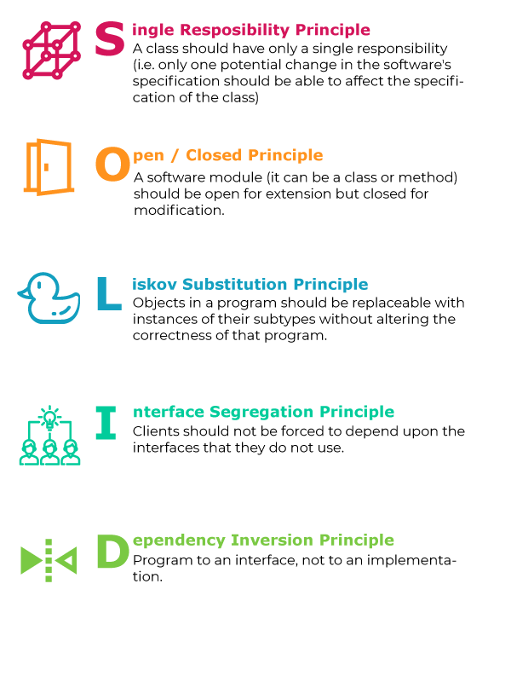
SOLID Principles
Single Responsibility Principle
Open/Closed Principle
Liskov Substitution Principle
Interface Segregation Principle
Dependency Inversion Principle
Notes:
SRP - Single responsibility
OCP - Extensibility Close for Modification.
LSP - How polymorphism should work
ISP - Interface should be designed.
DIP - Dependency Inversion Principle - Describes relationship between abstraction and concrete types.
Nothing like importance in order, i.e. which comes first.
Robert C. Martin or Uncle Bob
Initially 3 then he added 2 . No particular ordering.
His Colleague help to reorder so that it will spell SOLID.

Slide 9

Single Responsible principle (SRP)
Every module or class should have responsibility over a single part of the functionality provided by the software, and that responsibility should be entirely encapsulated by the class.
A class should have only one reason to change
Low coupling and High cohesion.
Notes:
SRP:
Doing one thing and do well.
This is a well-known principle in software design, and we've known for decades that this works very well.
There's a very well-known example of a piece of technology that applies this particular principle and has been successful for decades, and that's Unix. So Unix is based on this principle of doing one thing and do it well.
Now Unix is based on the command line, originally at least, so each thing that does something very well is small program, small command line, executable, and then Unix has a way to compose those executables into larger-scale programs.
And the success of Unix is continued by the success of Linux these days.
so we know that there are examples of this principle leading to systems that are very stable and very long-lived.

Slide 10
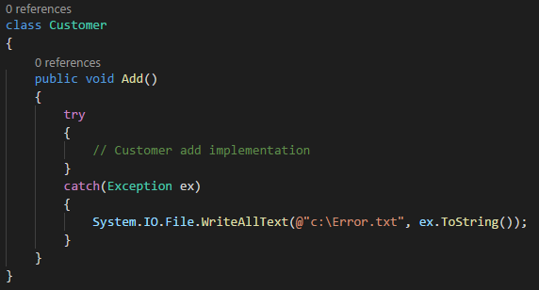
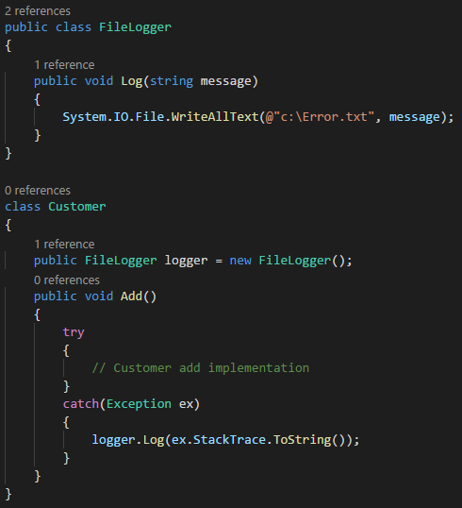
Single Responsible principle (SRP)
violation
solution
Notes:
Simple C# examples.
Call Data access layer etc.
Doing thing which is not supposed to do.
Catch block doing Logging.
SRP - Each concrete class is very specific.
------------------------------------------------
Move logging activity to some other class who will only look after logging activities.
Now customer class can happily delegate the logging activity to the “FileLogger” class and he can concentrate on customer related activities.

Slide 11
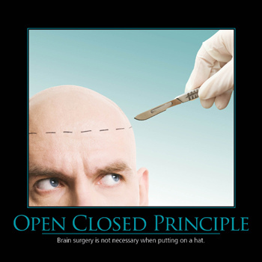
Open closed principle (OCP)
Software entities like classes, modules and functions should be open for extension but closed for modifications.
A class should have only one reason to change
Notes:
OCP:
O -Extensibility
C - Modification.
You have class in production - client rely on the class.
Then no longer allowed to change that class.
Changing the behaviour will have ripple effect on other.
Open for extensibility, which means that anyone should be able to extend the class in order to redefine parts of its behaviour.
---------------------------------------------------------------------------------------
Motivational Poster
Like wise: When you extend you software you should not need to go and dig around in its internals to just change its behavior.
Open to extension:
New behavior can be added in the future
Closed to Modification:
Changes to source or binary code are not required.

Slide 12
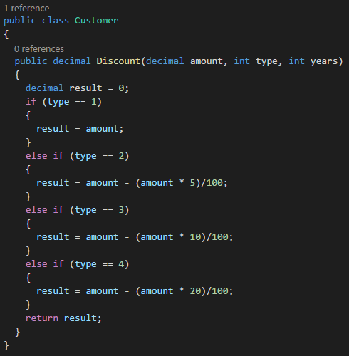
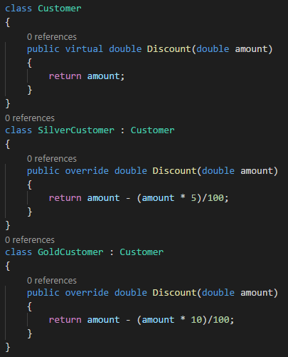
Open closed principle (OCP)
violation
solution
Notes:
Usecase -we have to give discount to customer based on customer type.
Added a simple customer type property to the class. This property decided if this is a “Gold” or “Silver” customer.
Problem: we add a new customer type we need to go and add one more “IF” condition in the “getDiscount” function,
MODIFYING” the current customer code for every change and every time we modify.
We need to ensure that all the previous functionalities and connected clients are working as before.
Instead of MODIFYING” we go for “EXTENSION”.
Every time a new customer type needs to be added, we create a new class.
If a Class in production – Have Profound impact on other, if you change.
Create a new class - Have behaviour
Add clients to it.
-----------------------------------------------------------
Adding virtual keyword make it open for extensibility.
Can override on or more behaviour.
We just need to test and check the new classes.
Example of this in .NET Framework.
.Net Framework published a versions of X509certificate class – which is used to model how an X509Certificate works, they realized that it was only really able to deal with a very specific format of an X509Certificate and they couldn't really move the X509Certificate class forward.
So in that case they actually ended up creating a new class called X509Certificate2, which is the class that you would usually use to manipulate X509 certificates today.
Open source – multiple version/copies. if you introduce breaking changes client will get irritated.

Slide 13
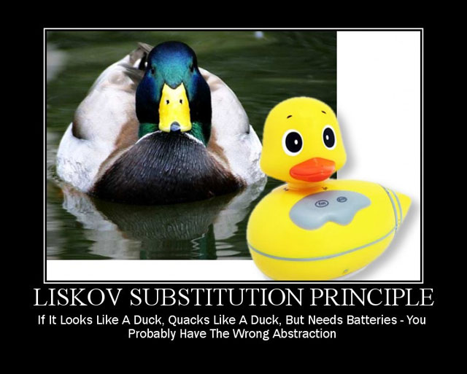
Liskov substitution principle (LSP)
Derived types must be completely substitutable for their base types.
Normal OOP inheritance
IS-A relationship
E.g. Dog is a kind of Animal
Liskov Substitution inheritance
IS-SUBSTITUTABLE-FOR
E.g. Animal is substitutable for Dog
Notes:
L in SOLID Principle. Barbar Liskov in 70s - in mathematical Greek language.
Robert c. Martin- Make it easy understandable
Subtype must be “substitute able” for their base type.
LISKOV principle says the parent should easily replace the child object.

Slide 14
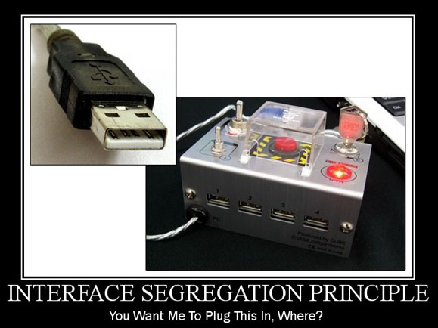
Interface Segregation principle (ISP)
Clients should not be forced to depend upon interfaces that they don't use.
Keep interfaces small, cohesive and focused.
ISP violates increasing in coupling and reducing the flexibility.
Notes:
I in SOLID principle.
LSP: We might end up having multiple interfaces.
Could have Interface with single method- called as marker interfaces.
Problem with LSP violation: get resolved by ISP?
“Abstraction are not designed but discovered by looking commonality in the code.”
Showing only essential feature.
Encapsulation - Hiding

Slide 15
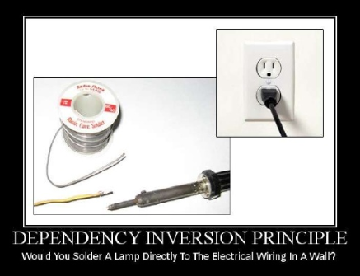
Dependency inversion principle (DIP)
High-level modules should not depend on low-level modules. Both should depend on abstractions.
Abstractions should not depend on details. Details should depend on abstractions
The Dependency Injection pattern is an application/ implementation of this principle
Three Primary Techniques
Constructor Injection
Property Injection
Parameter Injection
Notes:
This is closely related to the Interface Segregation Principle in the sense that clients own the interfaces, so a client can talk to an abstraction because it owns the interface.
User Interface depends on
Business Logic, depends on
Data access or utilities or infrastructure.

Slide 16
Other Programming Principles
DRY – Don’t Repeat Yourself
KISS – Keep it simple and stupid
YAGNI – You aren’t gonna need it
Notes:
Also known as Principles of object oriented design.
SOLID to make you more productive by making code more maintainable(Like encapsulation) but here focus is through decomposition and decoupling.
SOLID:
Not a framework/library.
Not technology bound.
Not concrete thing we can say it's SOLID. can't measure it. Never reach the goal, but you reach closer to closer.
Not a pattern.
Reaction to a set of specific code smells.
SOLID to address complexity. – ex. code takes time to understand, How it works. Before you do the refactoring.

Slide 17
Don’t Repeat Yourself (DRY)
Every piece of knowledge must have a single, unambiguous, authoritative representation within a system.
Violation of DRY :
Where a developer enjoy typing. Put lot of repeated codes.
Fix:
Use constants.
Move connection string to configuration file.

Slide 18
Keep It Simple and Stupid (KISS)
Most systems work best if they are kept simple rather than made complicated.
Programming language is for human to understand because computer only understand 0,1.
Keep your methods small, each method should never be more than 40-50 lines.
Each method should only solve one small problem, not many use cases.

Slide 19
You Aren’t Gonna Need It
Always implement things when you actually need them, never when you just foresee that you need them.
Write the code which you need in the current situation.
Add your code logic for the present, don't think of what may be needed in the future.

Slide 20
Q & A

Slide 21
Thank You
Sampath Bingi

